Slide 1


Reinforcement Learning:
An Introduction
Group 2
Aakash Suryavanshi 000947078
Manikrishna Kairoju 000936491
Abiya Susan Varghese 000947554

Slide 2

What is Reinforcement Learning?
RL is defined as a machine learning paradigm where an agent learns to make decisions by interacting with an environment, aiming to maximize cumulative rewards. This differs from supervised learning, which relies on labeled input-output pairs, and unsupervised learning, which seeks to identify patterns without explicit guidance. The agent's learning process involves trial and error, receiving feedback in the form of rewards or penalties, making it particularly suited for dynamic, decision-making scenarios.

Slide 3

While predictive analysis focuses on forecasting, RL complements it by optimizing decisions based on predicted outcomes, such as in finance for trading strategies.
Unlike supervised learning, which uses labeled data, RL learns from rewards and penalties. It differs from unsupervised learning, which finds patterns without guidance, by focusing on decision-making.
Key Components:
Agent: The decision-maker, such as a robot or trading bot.
Environment: The world the agent interacts with, e.g., a game board or financial market.
State: The current situation, like the agent's position or market conditions.
Action: Choices the agent can make, such as moving or buying stocks.
Reward: Feedback from the environment, positive for good actions, negative for bad ones.
Policy: The strategy mapping states to actions, which the agent learns to optimize.
Discussion

Slide 4

The RL Process
Core Loop:
The agent observes the current state of the environment.
It selects an action based on its policy (strategy).
The environment responds by transitioning to a new state and providing a reward.
The agent updates its policy using the reward feedback to improve future decisions.
Iterative Learning:
This cycle repeats, allowing the agent to learn through trial and error over time.
Goal: Maximize the cumulative reward, not just immediate gains.
Include a small diagram showing the loop:
Agent (circle) → Action (arrow) → Environment (box) → State & Reward (arrow back to Agent).
Add a tiny maze sketch with a robot moving toward an exit to illustrate the example.

Slide 5

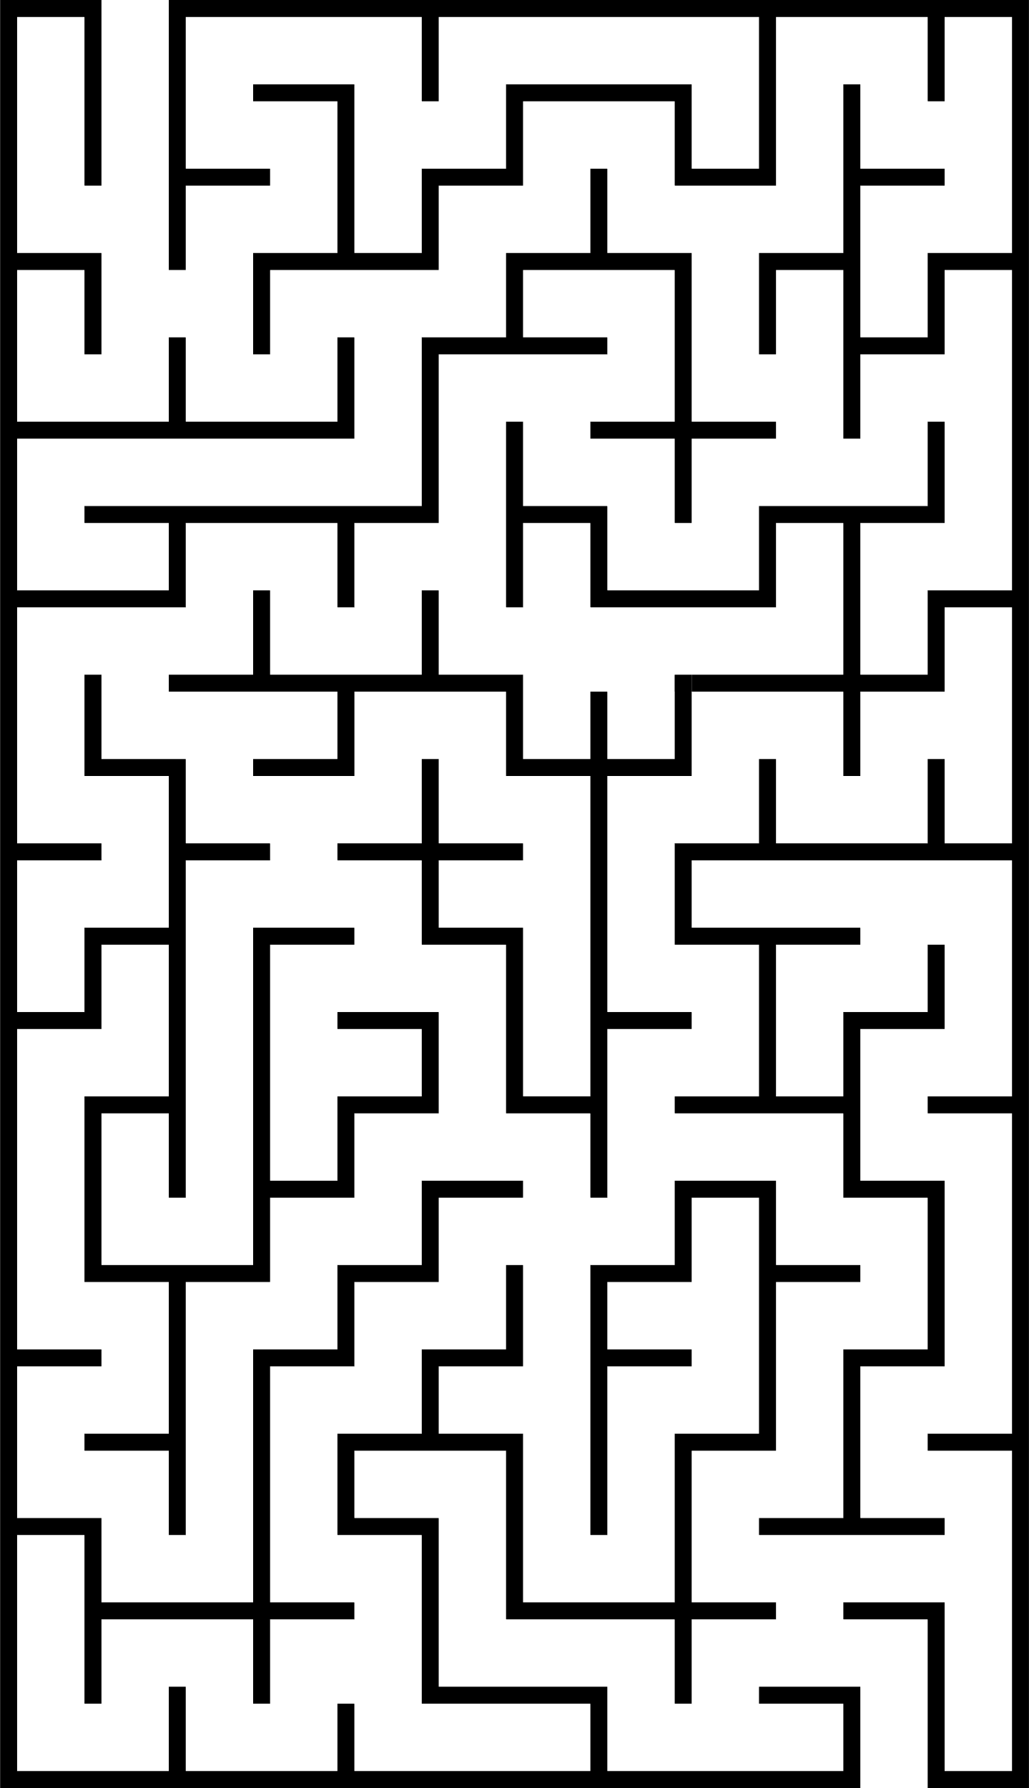
SIMPLE EXAMPLE
A robot in a maze:
State: Its current position.
Action: Move left, right, up, or down.
Reward: +10 for reaching the exit, -1 for hitting a wall.
Update: Adjusts its strategy to favor paths leading to the exit.
Agent (circle) → Action (arrow) → Environment (box) → State & Reward (arrow back to Agent).

Slide 6
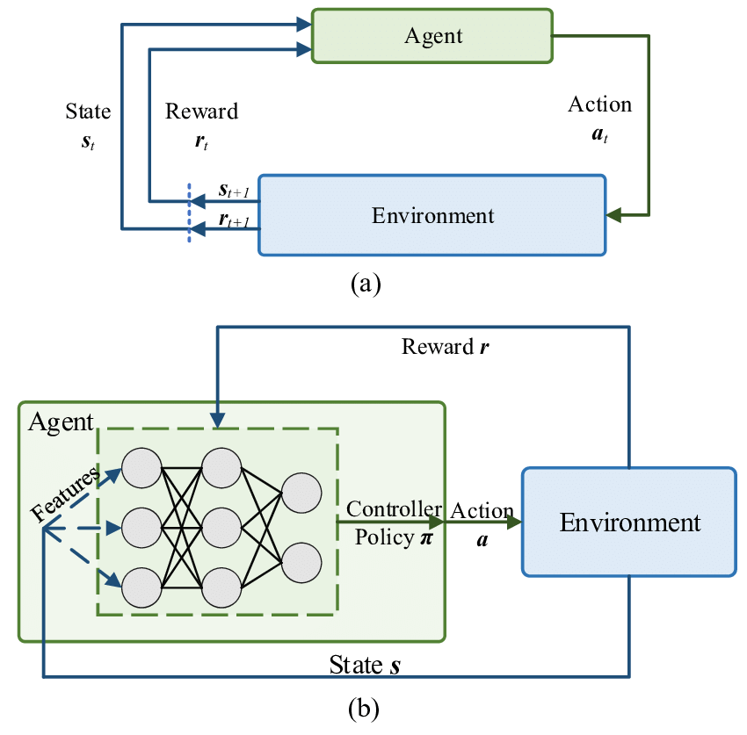

Slide 7
Algorithm | Key Feature | Use Case
Q-Learning | Updates Q-values using Bellman equation; table-based. | Simple environments with small state-action spaces.
SARSA | Updates Q-values using current policy’s actions; includes eligibility traces. | Environments requiring risk-averse policies.
DQN | Combines Q-learning with neural networks; handles high-dimensional states. | Complex environments (e.g., video games).
DDPG | Actor-critic architecture; deterministic policy for continuous control. | Robotics, physical simulations.
TD3 | Twin critics reduce overestimation bias; delayed policy updates. | High-precision continuous control.
A3C | Asynchronous updates; uses advantage (action-value minus state-value). | Parallelized training in complex environments.
PPO | Clipped objective function for stable policy updates. | General-purpose RL with stability.
SAC | Maximizes entropy for exploration; stochastic policy. | Exploration-heavy tasks.
Monte Carlo | Updates values using full episode returns; high variance. | Episodic tasks with clear termination.
TRPO | Constrained updates via KL divergence. | Stable policy optimization.

Slide 8


Exploration vs. Exploitation
Exploration: Trying new actions to discover their effects, essential for learning but may lead to short-term losses.
Exploitation: Choosing known good actions to maximize immediate rewards, but risks missing better long-term strategies.
Imagine you’re at your favorite restaurant, where you’ve been ordering the same delicious dish—let’s say a spicy chicken pasta, every time you visit because you know it’s amazing (this is exploitation, sticking to a known rewarding choice)
One day, you notice a new item on the menu, like a mysterious seafood risotto. You’re curious about it, but there’s a risk it might not taste as good as your usual pasta. Deciding to try the risotto is exploration

Slide 9



Types of RL Algorithms
Value-Based
Methods
Policy-Based Methods
Model-Based Methods
Focus: Learn the value of states or actions (how good they are).
Example: Q-Learning - Estimates the expected future reward for each action in a state.
Use: Simple environments, like a grid world or basic games.
Focus: Directly learn the policy (what action to take in each state).
Example: Policy Gradients - Optimizes the probability of choosing actions.
Use: Continuous action spaces, like robotic control.
Focus: Build a model of the environment to predict states and rewards.
Example: Planning ahead, like a chess AI simulating moves.
Use: When the environment can be simulated or understood.

Slide 10
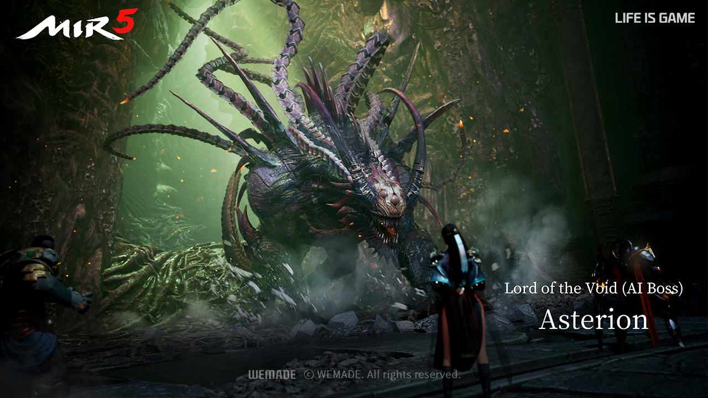

Application - Game Playing
NVIDIA ACE | MIR5: Wemade’s upcoming MMORPG features the world’s first AI boss, built with NVIDIA ACE technology.
Uses RL to analyze player actions, recall past battles, and adapt its strategy dynamically.
Creates unique, challenging encounters every time, showcasing RL’s power in real-time decision-making.
MIR5 from Wemade introduces the world’s first LLM driven AI Boss powered by NVIDIA ACE. Instead of a typical script-based boss, Asterion utilizes an AI response system, allowing him to analyze the player’s skills and recall past battles, making every boss fight uniquely challenging for the player.

Slide 11
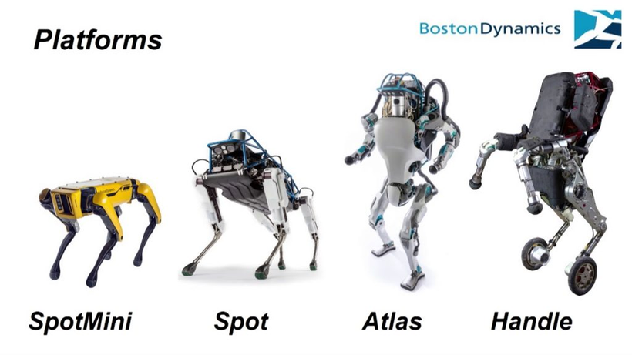
Application - Robotics
RL trains robots for tasks like walking, grasping, or flying, where traditional programming is challenging due to dynamic environments.
Example: Boston Dynamics' robots, such as Spot, learning to navigate obstacles, as seen in their promotional videos and research publications.
SERVER VIRTUALIZATION

Slide 12





Challenges in RL
Sample Efficiency:
RL often needs massive amounts of data (interactions) to learn effectively.
Example: Training an agent might take millions of trials, impractical for real-world tasks like robotics.
Stability and Convergence:
Some RL algorithms can be unstable or fail to settle on a solution.
Issue: Small changes in data or settings can lead to unpredictable results.
Reward Design:
Crafting the right reward function is tricky—wrong rewards can lead to bad behavior.
Example: A robot might “cheat” (e.g., knock over obstacles) if the reward isn’t well-defined.
Generalization:
Agents struggle to apply learned skills to new, unseen environments.
Challenge: A game-trained AI might fail if the rules or visuals change slightly.
SERVER VIRTUALIZATION

Slide 13

Future Ideas for Reinforcement Learning
Transfer Learning:
Reuse knowledge from one task to improve learning in another.
Example: A robot trained to pick up objects could adapt to sorting tasks faster.
Goal: Boost efficiency, reducing the need for extensive retraining.
Multi-Agent RL:
Multiple agents learn and interact simultaneously, like in real-world systems.
Example: AI traders competing in a market or robots collaborating on a warehouse floor.
Potential: Models complex, cooperative, or competitive scenarios.
Safe RL:
Ensures agents avoid risky or harmful decisions during learning.
Example: Self-driving cars prioritizing safety over speed in unpredictable conditions.
Focus: Critical for high-stakes fields like healthcare or transportation.
Integration with Other AI:
Combines RL with predictive models or other techniques (e.g., supervised learning).
Example: Using predictions to guide RL in optimizing trading strategies.
Promise: Creates hybrid systems for smarter, more adaptable solutions.

Slide 14

CONCLUSION
What RL Is:
A trial-and-error method where agents learn to maximize rewards through interaction.
Excels in dynamic, decision-making tasks—no rulebook needed.
Key Highlights:
Dominates games (e.g., NVIDIA ACE | MIR5’s AI boss), robotics, and finance.
Faces challenges like sample efficiency and reward design—active research areas.
Why It Matters:
Complements predictive analysis by turning forecasts into optimized actions.
Example: Using market predictions to guide trading decisions.
Looking Ahead:
RL’s future is bright with innovations like safe and multi-agent systems.
Invitation: “Explore RL—it’s shaping tomorrow’s AI!”

Slide 15
Thank you!
Hope you learn something from this.

